Slide 1
PPR Code Segment Practice
Create Performance Task

Slide 2

AP CSP Create Performance Task
Part of the AP Exam is to create a program that meets specific requirements:
Creates a list
Uses a list in a meaningful way
Has a function with a parameter
  Parameter affects function execution
Function has:
  If statement
  Loop

Slide 3
AP CSP Create Performance Task
After you create your program, you will submit three things in the digital portfolio:
A PDF of your entire code (including comments)
A short video (< 1 minute) of your code working
A Personal Project Reference (PPR) that contains four code segments of the code

Slide 4
AP CSP Create PT PPR
This lesson will focus on the Personalized Project Reference (PPR):
The PPR is unique for each student.
You cannot have any help when creating your PPR – each student must create their own PPR independently.
The PPR cannot have any comments!
The PPR will be printed for each student to use during the Free Response Questions of the AP Exam.
NOTE: This part MUST be completed individually, even if you work with a partner on the project.

Slide 5
AP CSP Create PT PPR
For this lesson, you will:
Identify specific parts of your code needed for the PPR.
Make images of the code and download the images.
Insert the images by uploading them into a document.

Slide 6
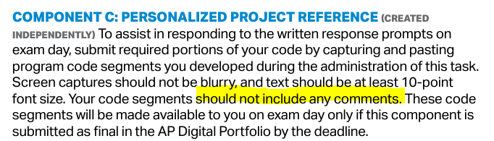
AP CSP Create Performance Task
From the student handout:

Slide 7
AP CSP Create PT PPR
Getting your code ready for selecting images.
Go to the Sandbox in CodeSpace.
Open the PT_Practice1 program.

Slide 8

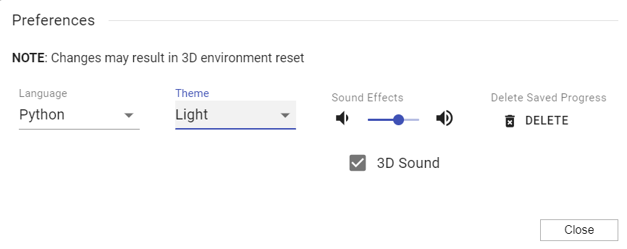
AP CSP Create PT PPR
The code will easier to print and view if it is printed as black text on a white background.
Click on the settings icon.
Change the theme to light.

Slide 9
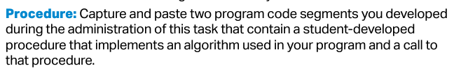
AP CSP Create PT PPR
Start with the first image.
From the student handout:

Slide 10
AP CSP Create PT PPR
The first code segment you are asked to identify is the procedure you created that meets the requirements.
In PT_Practice1, the turn_pixels(choice) function meets the requirements.
You will create an image of the entire function.
Make sure there are no comments in your function!
Use the snipping tool.

Slide 11

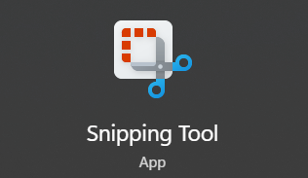
AP CSP Create PT PPR
On a Windows PC or laptop, use the snipping tool.
Go to the search bar and type “snip”
The snipping tool should show up. Click on it.

Slide 12

AP CSP Create PT PPR
Make sure the entire turn_pixels() function shows on your screen.
In the snipping tool, click New.
Use your mouse to draw a white rectangle around the function.

Slide 13
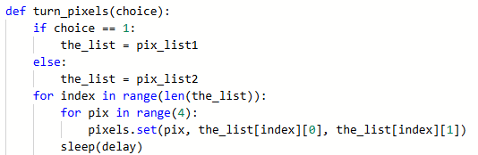
AP CSP Create PT PPR
Your code segment should look like this:

Slide 14
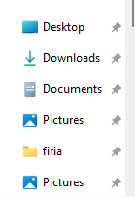

AP CSP Create PT PPR
Save the snippet.
Click on the disk icon.
Change the name to something descriptive, like my_function
Click on the location you want to save it to.

Slide 15
AP CSP Create PT PPR
Repeat this process for the other three required code segments.
You can leave the snipping tool open and click New for each code segment.
Give each code segment a unique and descriptive name.
The other code segments are detailed on the next slides.

Slide 16
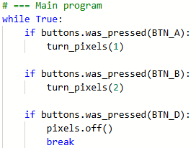
AP CSP Create PT PPR
Second code segment: where the function is called.
In this program, it is called twice.
You can include one or both function calls.

Slide 17

AP CSP Create PT PPR
Third code segment: a list being created.
If you have more than one list, you only need to include one.
If the code segment shows more than one list, the AP reader will only consider the first list shown.

Slide 18
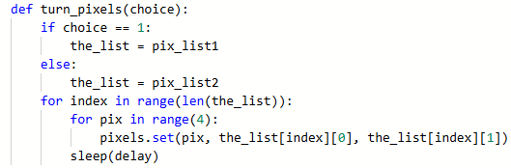
AP CSP Create PT PPR
Fourth code segment: the same list being used.
Make sure you use the same list as you did for part iii.
For this program, you can include the entire function, since it shows the list being used in the loop, and it gives you some context for explaining the code later.

Slide 19
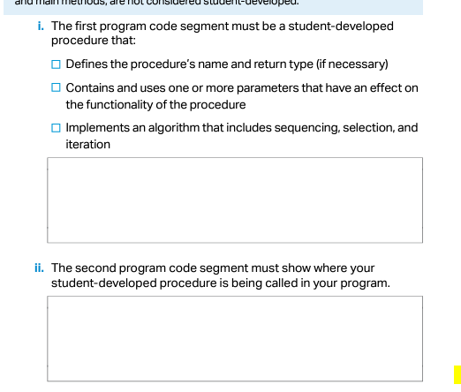
AP CSP Create PT PPR
You should have four unique code segments saved as PNG images.
You should be able to find these code segments.
You are ready to upload your images.
For today’s lesson, you will upload them by inserting them into the Activity Guide.

Slide 20
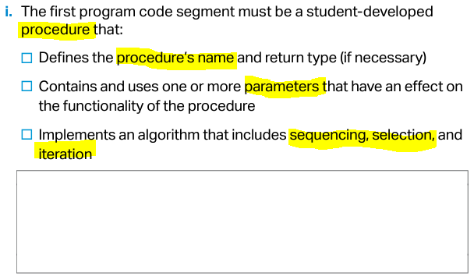
Code Segment #1

Slide 21
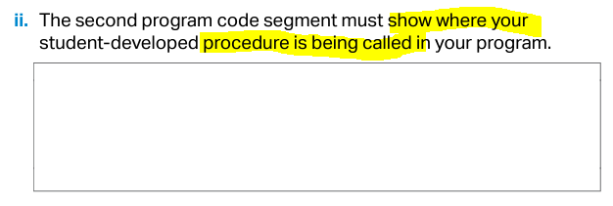
Code Segment #2

Slide 22
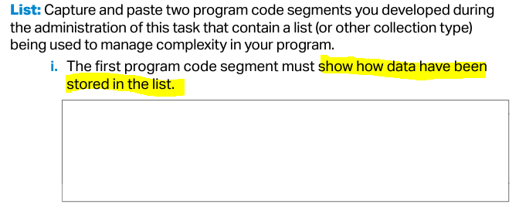
Code Segment #3

Slide 23
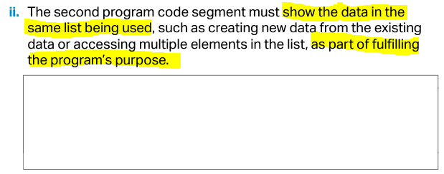
Code Segment #4

Slide 24
AP CSP Create PT PPR
More practice!
Go to the Sandbox in CodeSpace.
Open the PT_Practice2 program.
Look through the code.
What will you use for:
  The student-created function
  The function call
  The list with elements
  The list being used

Slide 25
AP CSP Create PT PPR
More practice!
Try identifying and creating the code snippets on your own.
Compare your code snippets with other students.
Do you agree with each other?
Upload your code segments to the Activity Guide.

Slide 26
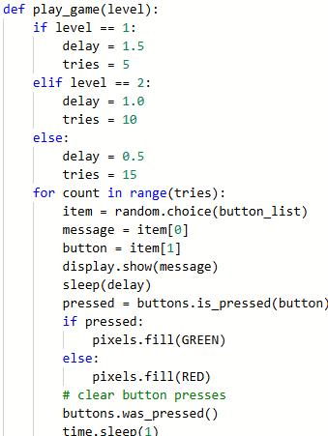
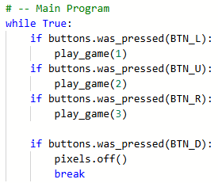
AP CSP Create PT PPR
Possible code snippets for PT_Practice2 (i and ii)

Slide 27

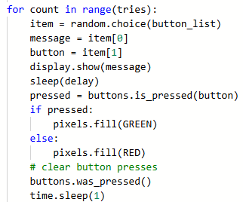
AP CSP Create PT PPR
Possible code snippets for PT_Practice2 (iii and iv)

Slide 28
AP CSP Create PT PPR
More practice!
Go to the Sandbox in CodeSpace.
Open the PT_Practice3 program.
Look through the code.
What will you use for:
  The student-created function
  The function call
  The list with elements
  The list being used

Slide 29
AP CSP Create PT PPR
More practice!
Identify and create the code snippets on your own.
Compare your code snippets with other students.
Do you agree with each other?
Upload your code segments to the Activity Guide.

Slide 30
AP CSP Create PT PPR
More practice!
Go to the Sandbox in CodeSpace.
Open the PT_Practice4 program.
Look through the code.
What will you use for:
  The student-created function
  The function call
  The list with elements
  The list being used

Slide 31
AP CSP Create PT PPR
More practice!
Identify and create the code snippets on your own.
Compare your code snippets with other students.
Do you agree with each other?
Upload your code segments to the Activity Guide.

Slide 32
AP CSP Create PT PPR
PPR Reminders – Things to do
First segment: Include the ENTIRE function, with parameter
  Try to do one image for the entire function.
  If your function is really long, you can include two images.
  If your function calls another function that includes a requirement, include the image of the second function as the second image (not the first!).

Slide 33
AP CSP Create PT PPR
PPR Reminders – Things to do
Second segment: Include the section of code that shows the function being called.
  The function call must be to the same function used in the first segment.
  Include the argument being passed to the parameter.
  You can include lines of code above and below the function call for reference, but no comments!

Slide 34
AP CSP Create PT PPR
PPR Reminders – Things to do
Third segment: Include the entire list.
  Show it storing data.
  Do not use an empty list for this segment.
Fourth segment: Use the same list as the one in the third segment.
  You can include code above and below where the list is used for reference.

Slide 35
AP CSP Create PT PPR
Final comments about the PPR
Make sure your text is large enough to read. If you have a long line, like for a list, consider breaking it up into several lines.
Black text on white background is easier to print and read than white text on black background.
No comments at all in the PPR!
You can have up to three images in each box.
The PPR must be created independently – no collaboration or help!

